Slide 1

Electromigration in Solid Oxide Fuel Cells
Final Project
By
Khaleda Akter

Slide 2
Contents
01
Electromigration Fundamentals
02
Factors Affecting Electromigration
03
Electromigration in SOFCs

Slide 3

01
Electromigration Fundamentals

Slide 4
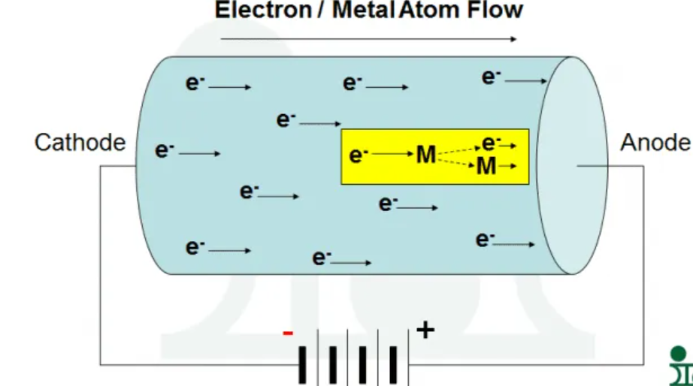
What is Electromigration?
The transport of the charged atoms in a conductor due to the local electrical field and the momentum transfer between charged atoms and electrons.
This is a well-known phenomenon in microelectronics and is becoming increasingly significant in energy systems.
Occurs under high current densities and elevated temperatures

Slide 5
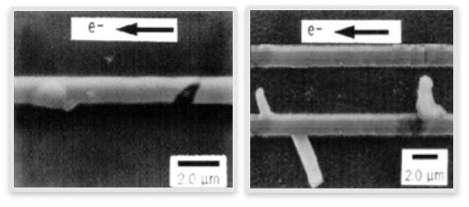
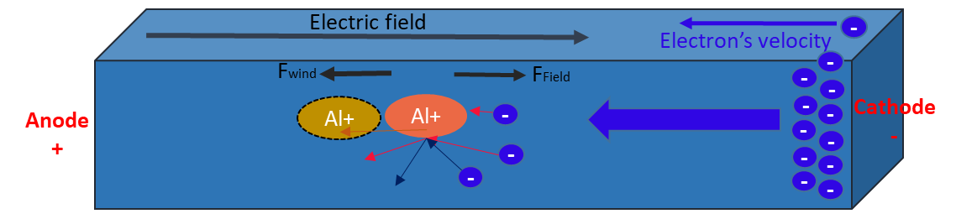
Electromigration Mechanism
Driven by two forces: electron wind and electrostatic field.
Results in voids and hillocks
Involves movement of metal ions, leading to microstructural degradation.
Effect
Hillock
Voids
Outgoing Ion flux exceeds the incoming ion flux
Incoming Ion flux exceeds the outgoing ion flux

Slide 6
02
Factors Affecting Electromigration

Slide 7
Acceleration of Electromigration
Electromigration Effects Across Devices
Moisture
Device Type | Location of EM | Main Consequence
Microchips (ICs) | Interconnects (Cu, Al) | Open/short circuits
Lithium-ion batteries | Cu/Al collectors, Li metal | Voids, dendrites
SOFCs | Ni in anode | Nickel migration
LEDs | Solder joints, metal lines | Brightness drop, device failure
MEMS/NEMS | Metal micro-traces | Functional failure
Flexible electronics | Printed conductors | Loss of performance
RF modules | Transmission lines | Signal degradation
Contaminant on the insulator surface
Operating Conditions
Acceleration of Electromigration
Voltage difference
Narrow Spacing width
Elevated temperature

Slide 8
03
Electromigration in SOFC

Slide 9
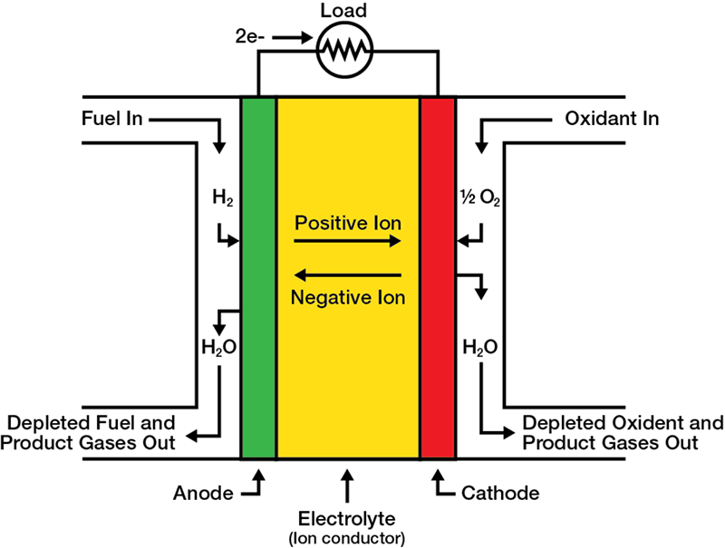
Overview of Solid Oxide Fuel Cells (SOFCs)
Key components: Ni–YSZ anode, YSZ electrolyte, and LSM/LSCF cathode.
Operate at 600–1000°C, enabling oxygen ion conduction.

Slide 10
Electromigration in SOFCs
Elevated Temperature
Contaminants
Steam
Operating Conditions of SOFC
Low Current Density
Electromigration
Krumbein, 1987; Tu, 2003

Slide 11
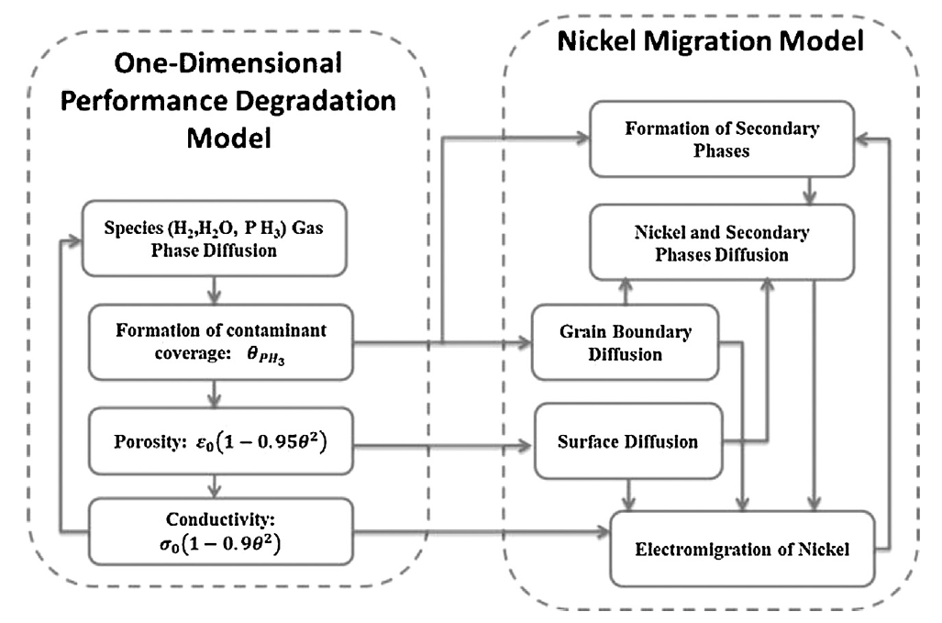
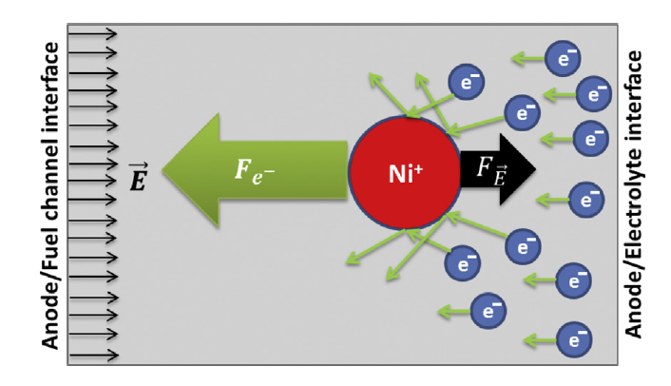

Electromigration in SOFC Anode
Applied Electrical Field
Electron Wind Force
Sezer and Celik, 2015

Slide 12
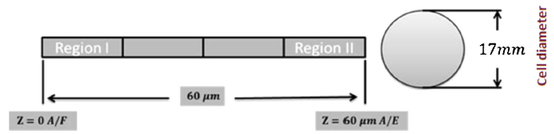
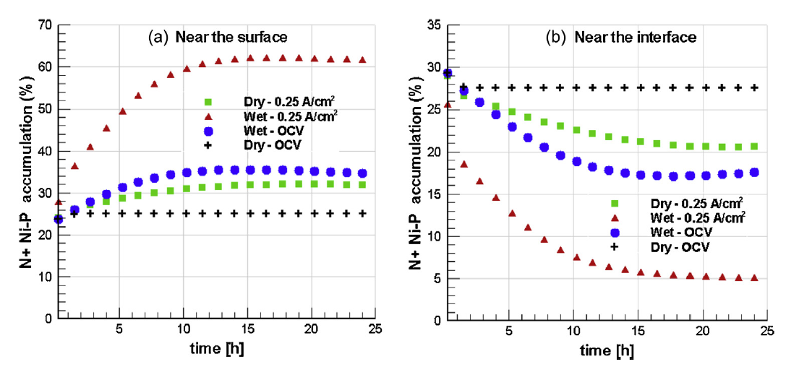
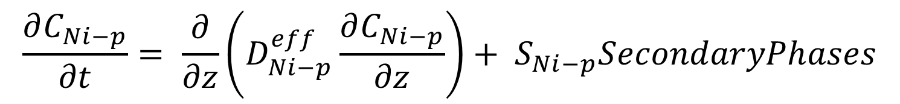
Electromigration in SOFC
Sezer and Celik, 2015

Slide 13
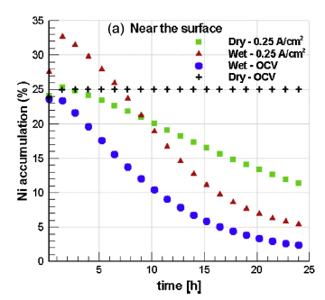
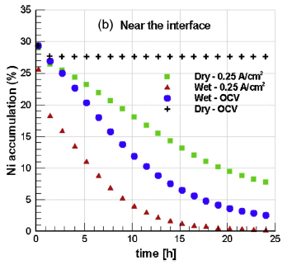
Electromigration in SOFC
Sezer and Celik, 2015

Slide 14
Conclusion
Electromigration is a process of metallic ion transfer due to the dominant force of momentum transfer of electron wind.
Many electrical and energy storage devices develop performance issue due to this electromigration.
In SOFC anode, Ni migration is a well-known performance degradation phenomenon due to electromigration from anode/electrolyte interface to anode/fuel surface.

Slide 15
References
[1] Sezer , H, Celik, I, “Phosphine induced Nickel Migration in SOFC Anodes: A Computational Study”, Electrochimica Acta, 2015, Vol 155, pp. 421 – 430.
[2] Krumbein, S.J., Metallic Electromigration Phenomena, in 33rd Holm Conference on Electrical Contacts, Chicago, Illinois, 1987.
[3] K. Tu, N., Recent advances on electromigration in very-large-scale-integration of interconnects, Journal of Applied Physics 94 (7) (Nov. 2003) 5451–5473.
[4] Finklea H., Diffusion mechanism in SOFC anode under operating condition, Private communication, Aug. 2014.
[5] Popovich M., Mezhiba A.V., Friedman E.G., Electromigration, in Power Distribution Networks with On-Chip Decoupling Capacitors. New York: Springer Science, 2008, ch. 4, pp. 71–86.
[6] Pierce D.G., Brusius P.G., ELECTROMIGRATION: A REVIEW, Microelectron. Reliab., vol. 37, no. 7, pp. 1053–1072, 1997.
[7] S.J. Krumbein, Tutorial: Electrolytic Models for Metallic Electromigration Failure Mechanisms, IEEE Transactions on Reliability vol. 44 (1995) no. 4.

Slide 16

Thank You!

